Slide 1
Detection of Fraudulent Transactions
Wanran Li

Slide 2
I. Increase in online fraudulent transactions
2019 American Express Digital Payments Survey
27% of annual online sales are fraudulent
77% of companies has been a victim of some type of fraud
53% of consumers report having been the victim of fraud

Slide 3
II. Data Acquisition & Cleaning
Combine 2 datasets: transaction and identity datasets from Kaggle
provided by Vesta Corporation, a payment service company
https://www.kaggle.com/c/ieee-fraud-detection/data
Data shape (590540, 434) after merge on TransactionID

Slide 4
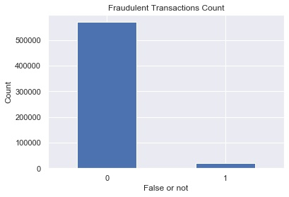
III. EDA 3.1 Imbalance of Fraud Transactions
3.5% is fraudulent transactions

Slide 5
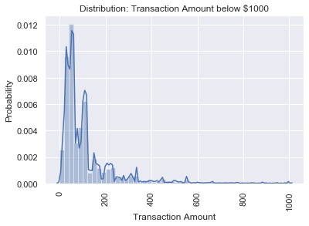
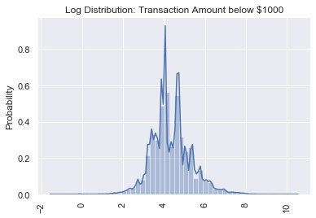
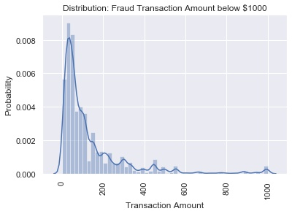
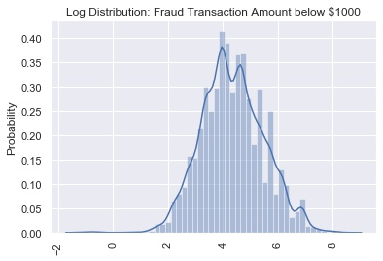
3.2 Transactions by Amount
All data:
Median value: $68
99% of transactions < $1,100
Filter by fraud transaction
Median value: $75
99% of transactions < $994

Slide 6
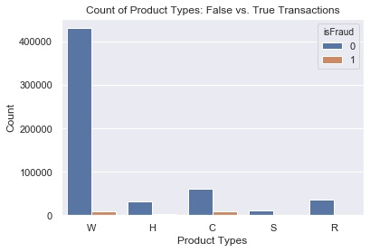
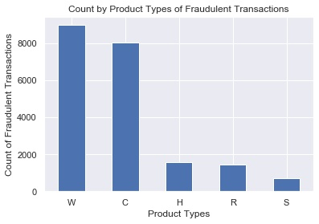
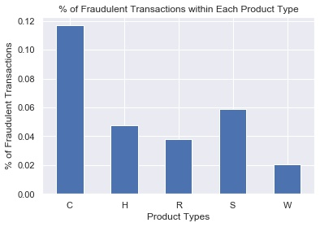
3.3 Transactions by Product Types
All data:
Most common types: W, C, R
Filter by fraud transaction
Most fraudulent transactions: W, C, H
Highest ratio within each type: C, S, H

Slide 7

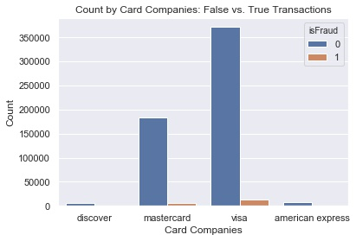
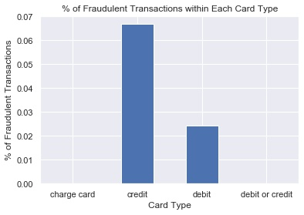
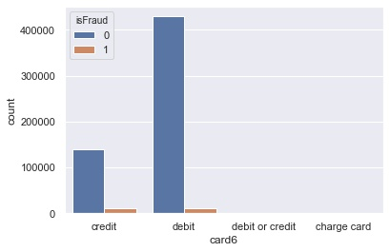
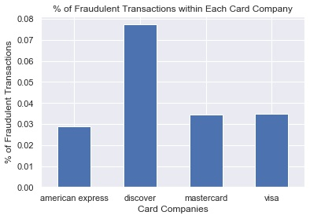
3.4 Transactions by Cards
Card company
Most common: visa, mastercard, amex
Most fraud transactions: visa, mastercard, discover
Highest ratio: discover, visa, mastercard
Card types
Most common: debit, credit
Most fraud transactions: debit, credit
Highest ratio: credit, debit

Slide 8
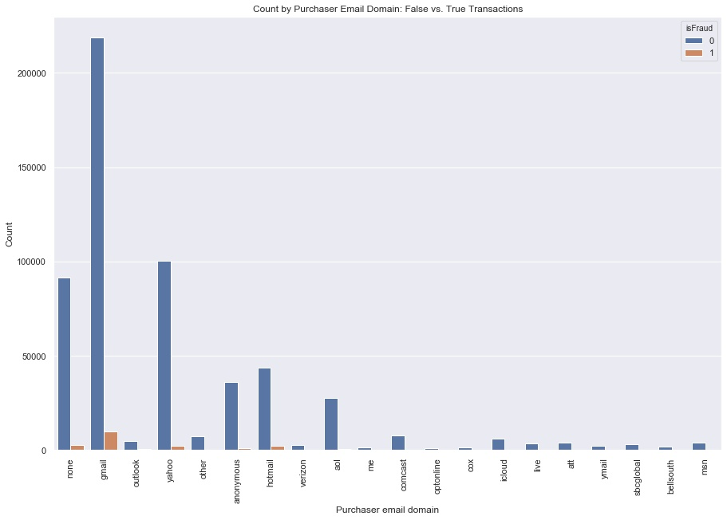
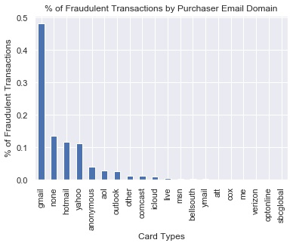
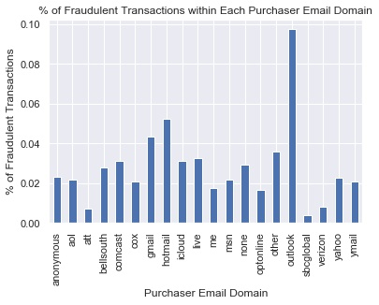
3.5 Transactions by Email Address
Purchaser email domain:
Most common: gmail, yahoo, Hotmail
Most fraud: gmail, Hotmail, yahoo
Highest ratio: outlook, Hotmail, gmail

Slide 9
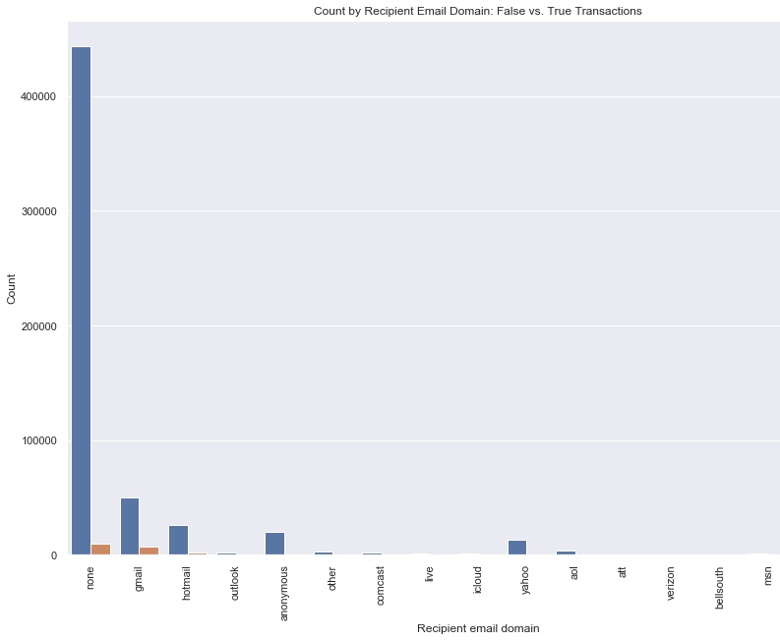
Recipient email domain
76.8% null values
Most common: gmail, Hotmail, anonymous

Slide 10
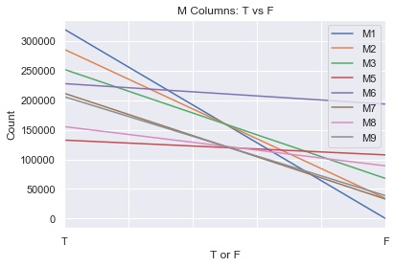
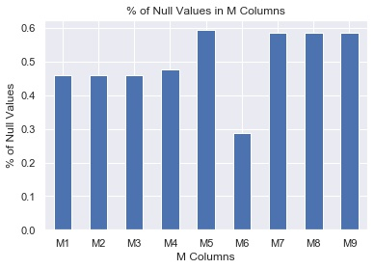
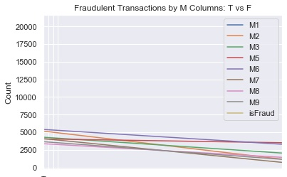
3.6 M1-M9 Columns
Match status: 50% missing data
All M columns (except M4) have more T than F values

Slide 11
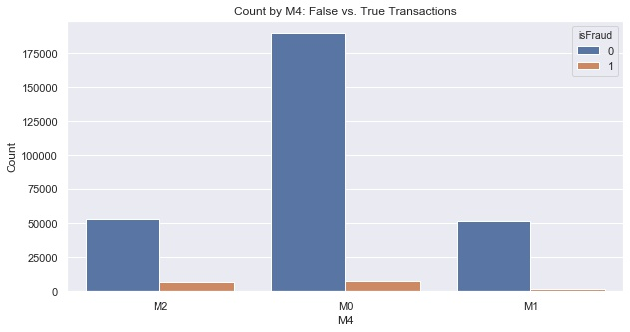
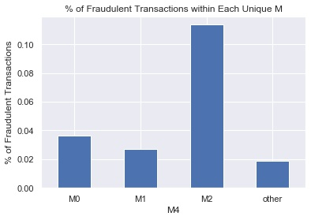
M4 Column:
Most common: M0, M2, M1
Most fraud: M0, M2, M1
Highest ratio: M2. M0, M1

Slide 12
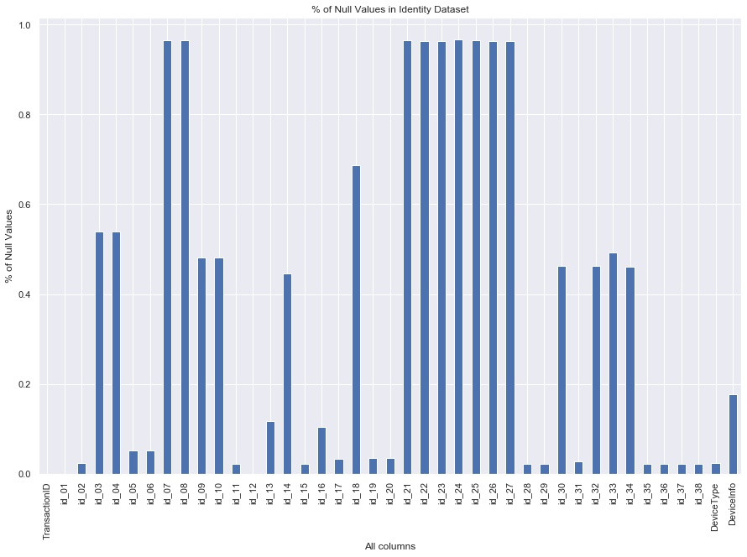
3.7 Identity Dataset Analysis
Half of the columns have over 50% null values

Slide 13
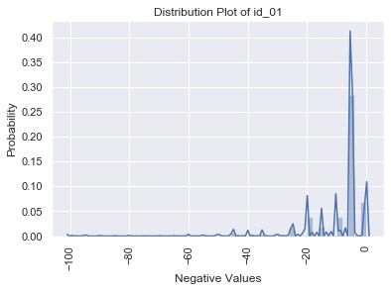
1) Column “id_01”
Values range from -100 to 0
Values center around -5

Slide 14
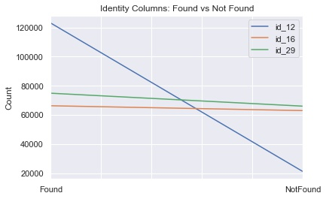
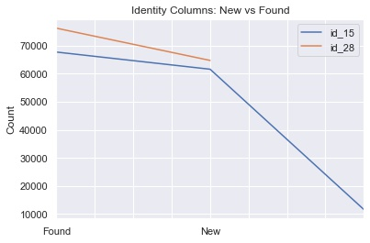
2) Count of id columns with “Found”
More found than notfound
Found > New > Unknow

Slide 15
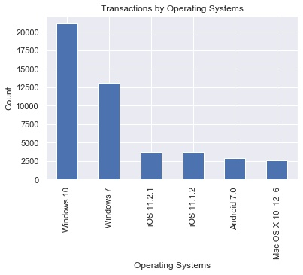
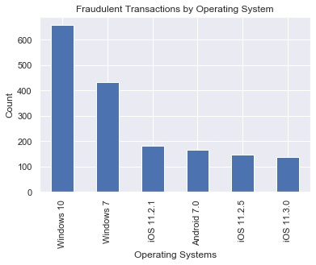
3) Users’ Operating Systems

Slide 16
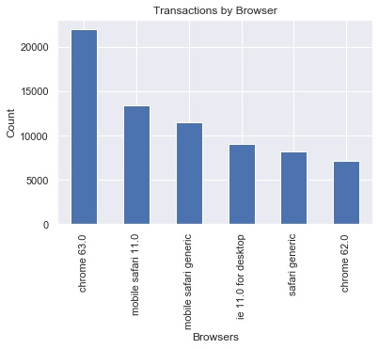
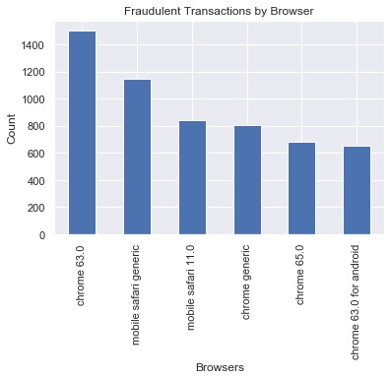
4) Browsers

Slide 17
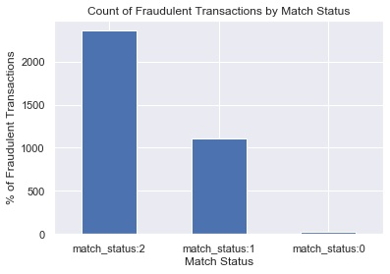
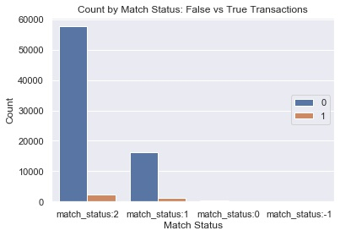
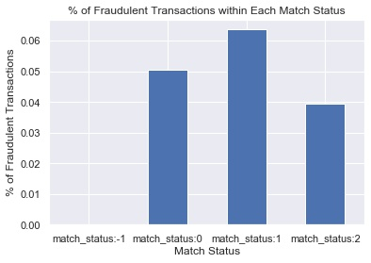
5) Match Status

Slide 18
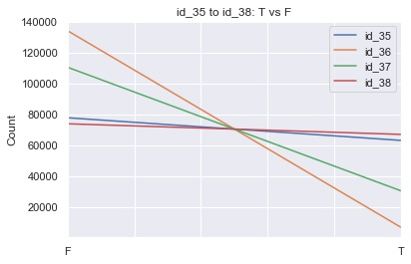
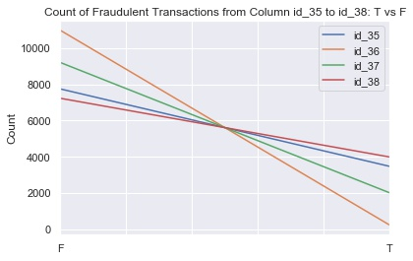
6) Columns “id_35” – “id_38”
2.25% missing data
More F than T values

Slide 19
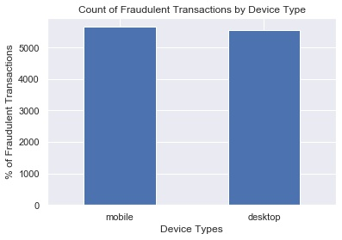
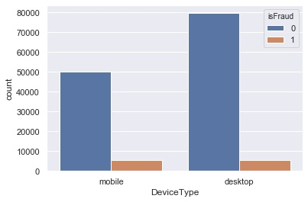
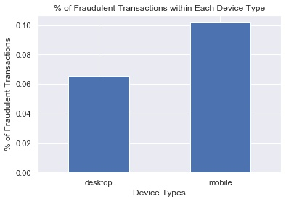
7) Column “DeviceType”
Most common: desktop > mobile
Most fraud: desktop > mobile
Ratio: mobile > desktop

Slide 20
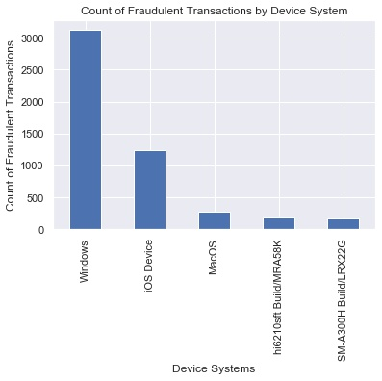
8) Column “DeviceInfo”
Top 3: Windows, iOS device, MacOS

Slide 21
IV. Modeling
Binary Classification Problem: Is it a fraudulent transaction?
Prepping Data for ML
Identify and remove all columns with:
1) 1 unique value
2) over 90% null values
3) near zero variance predictors
Convert categorical features into numerical values: LabelEncoder
Fill all NaN with an extreme number -999

Slide 22
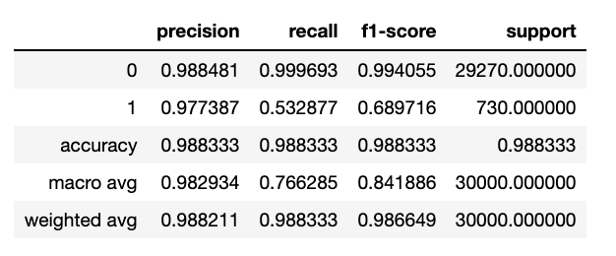
XGBoost: high speed execution and better model performance
objective = 'binary:logistic’
3-fold cross validation
Accuracy: 988
Classification_report
Precision: around 0.98 for both
Recall: fraudulent class – 0.532
F1-score: fraudulent class – 0.69

Slide 23
V. Limitations
Confidential business info
Analysis would be more meaningful if we know what values in the dataset represent (e.g. product type, transaction time and date in “TransactionDT” column)
Better model performance
Higher computing power for hyperparameter tuning and training data
Identify and select key features for the model

